Slide 1

A Reactive Online Optimization Based Whole Body Contol for Quadruped Locomotion Over Challenging Terrain
[CE554] Mechanical Design of Civil Robot
Team 2
20185570 - Hong Seung woo
20183633 - Choe JongHun
November 6, 2018

Slide 2
Table of Contents
Theme
Experiment Setup
High-level Controller
Low-level Controller
Result & Future Work

Slide 3
1. Theme
l Motivation
Reliable Locomotion Control framework for Quadruped Robot:
Compliant: to adapt impact force
Robust: to counteract the perturbations from contact situations
Reactive: to recover balance under large pushes

Slide 4
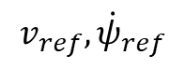
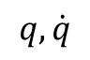
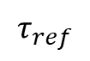
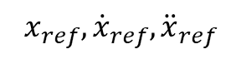
1. Theme
l Proposed Control Framework
High-level controller: uses a simplified model that generates dynamically stable foot stepping location to reduce complexity of algorithm and reactive to disturbances
Low-level controller: uses a full body inverse dynamics providing compliant motions and robustness
$$v_{ref},{\dot{ψ}}_{ref}$$
Simplified Model
High-level controller
Outputs stable foot stepping location and trajectory
- Ease complexity
- Reactiveness
$$x_{ref},{\dot{x}}_{ref},{\ddot{x}}_{ref}$$
Full Body Model
Outputs optimal torque to track the trajectory using inverse dynamics
Low-level controller
- Compliance
- Robustness
$$τ_{ref}$$
Robot
$$q, \dot{q}$$

Slide 5
1. Theme
l Contributions
Designed a reliable locomotion control framework:
High-level controller:
Reactive: can stabilize balance from large pushes (push recovery)
No drift: can prevent CoM drift
Low-level controller:
Compliant: can adapt large impact force (foot landing case)
Robust: can counteract the perturbations (uneven terrain)
Full optimization vector: can handle contact forces, contact constraints explicitly
Online optimization: can solve QP problem in real-time

Slide 6
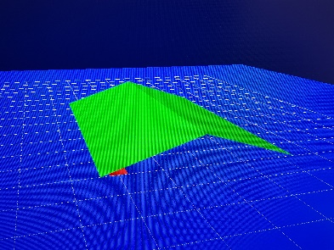
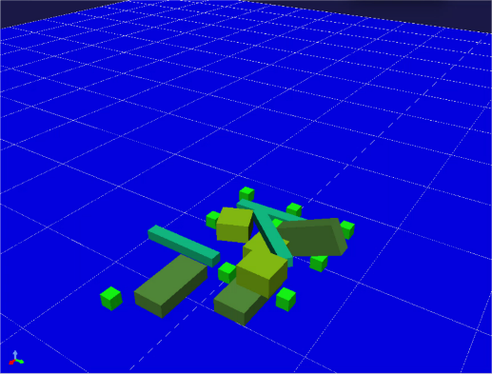
2. Experiment Setup
l To verify the overall performance of proposed control framework:
Uneven terrain: Slope, debris
Slope (over 30°)
Debris
Push recovery: withstand 200~600 N push [2], [3]
[2]: a 70kg quadruped robot withstands up to 600 N push
[3]: a 40kg quadruped robot, withstands up to 200 N push
Versatile dynamic gaits: trot, pace, bound, etc.
[2] Barasuol, V., Buchli, J., Semini, C., Frigerio, M., De Pieri, E. R., & Caldwell, D. G. (2013, May). A reactive controller framework for quadrupedal locomotion on challenging terrain. In ICRA (pp. 2554-2561).
[3] Khorram, Mahdi, and S. Ali A. Moosavian. "Push recovery of a quadruped robot on challenging terrains." Robotica 35.8 (2017): 1670-1689.

Slide 7
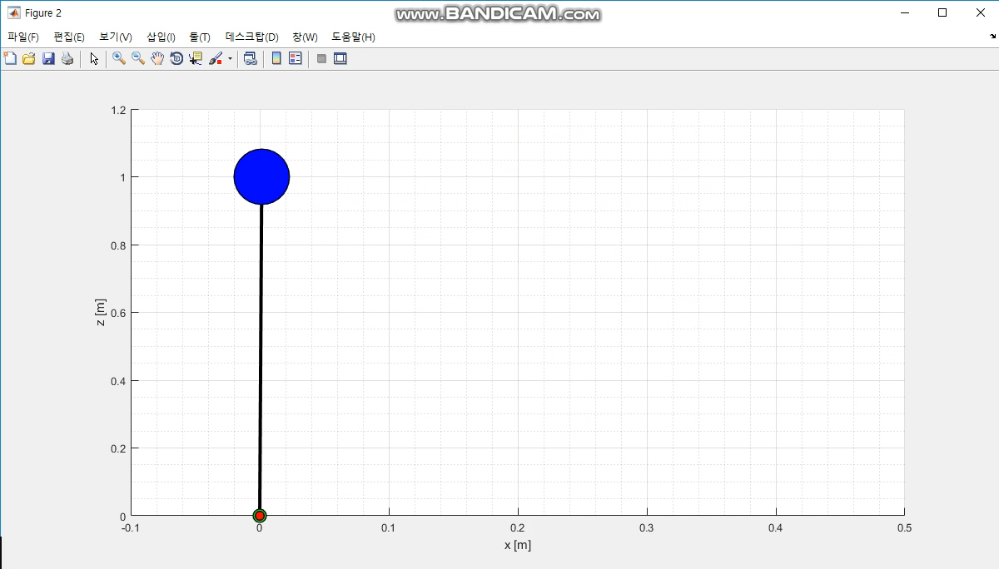
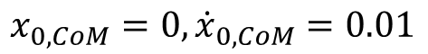
3. High-Level Controller
Linear Inverted Pendulum Model (LIPM)
$$x_{0, CoM}=0, {\dot{x}}_{0,CoM}=0.01$$

Slide 8
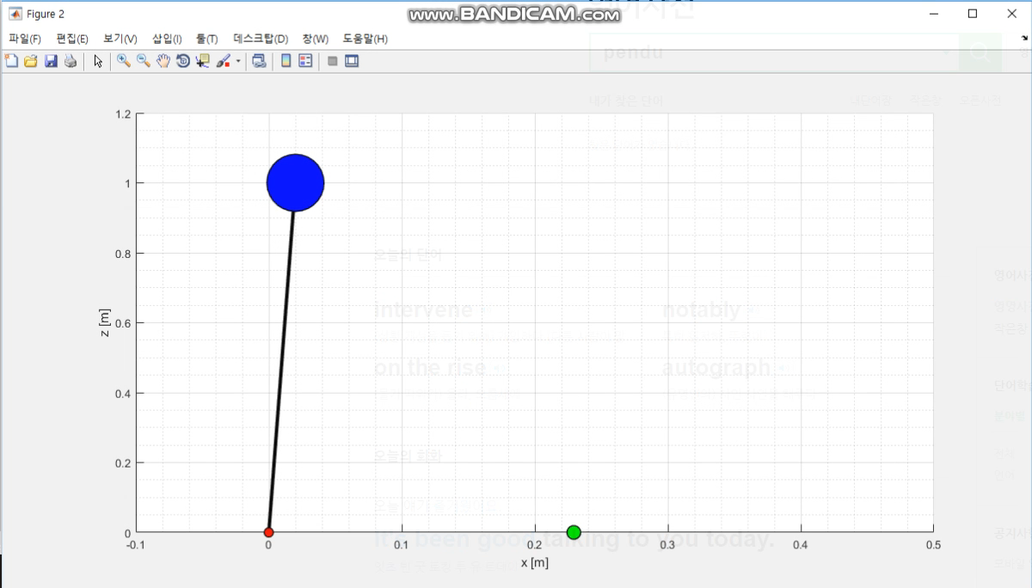
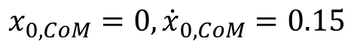
3. High-Level Controller
Capture Point (CP): $ξ$
$$x_{0, CoM}=0, {\dot{x}}_{0,CoM}=0.15$$

Slide 9
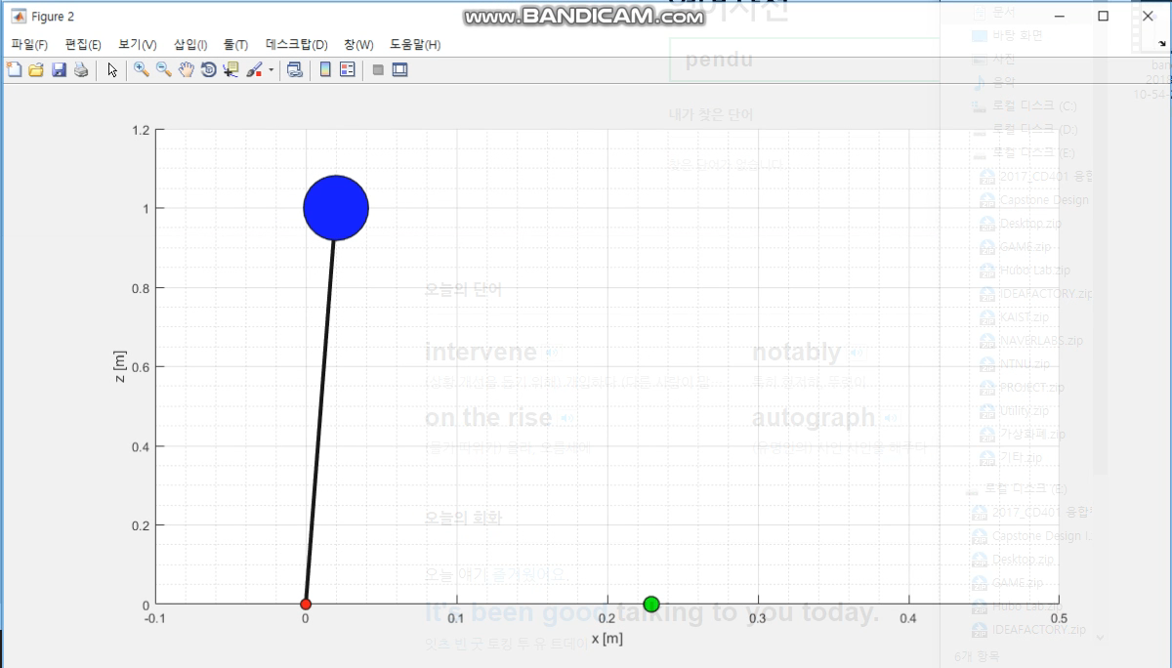
3. High-Level Controller
Capture Point with offset
$$x_{0, CoM}=0, {\dot{x}}_{0,CoM}=0.15, offset=0.005$$
Deceleration!

Slide 10
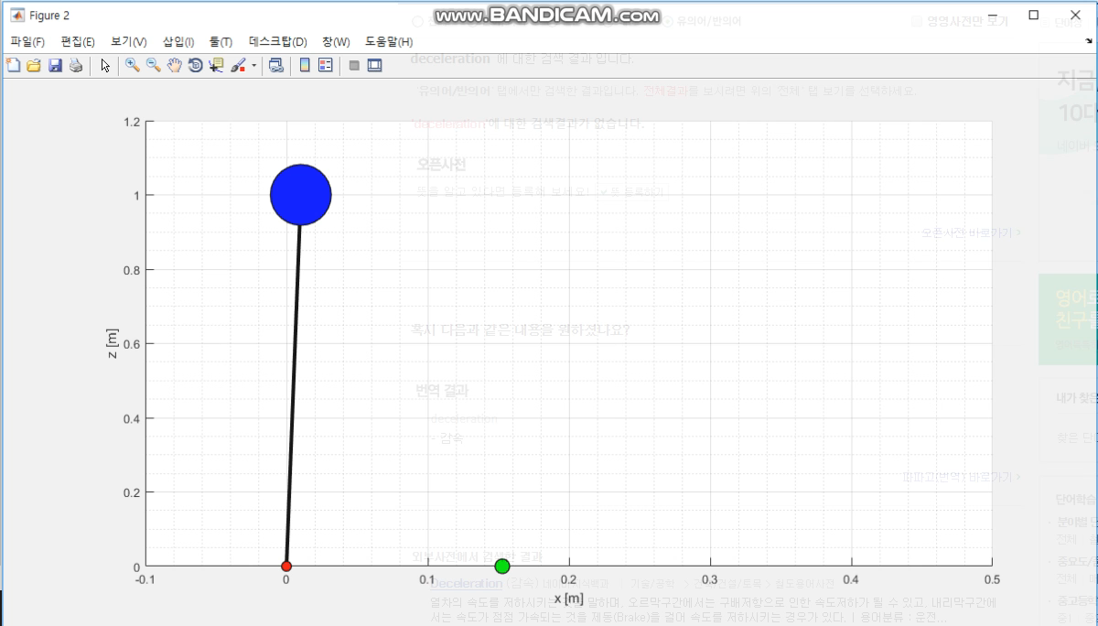
3. High-Level Controller
Capture Point with offset
$$x_{0, CoM}=0, {\dot{x}}_{0,CoM}=0.15, offset=−0.005$$
Acceleration!

Slide 11
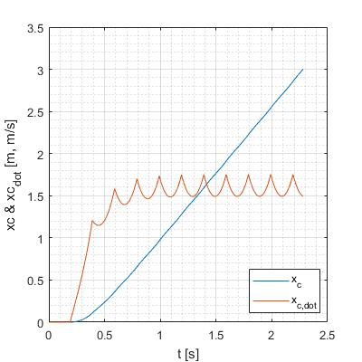
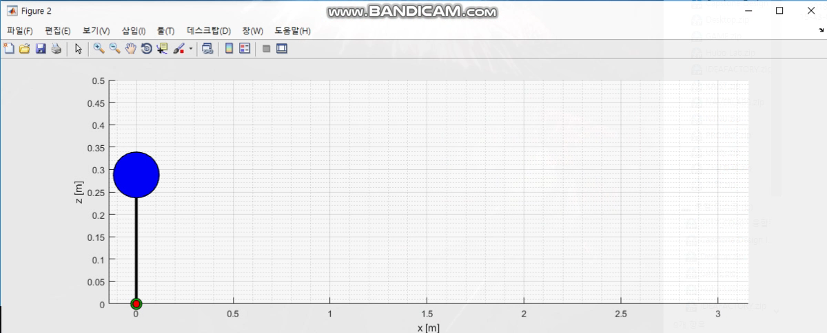
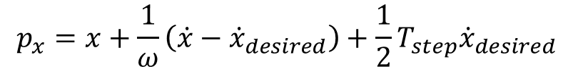
3. High-Level Controller
To follow specific desired CoM velocity[1],
$$p_{x}=x+\frac{1}{ω}\left(\dot{x}−{\dot{x}}_{desired}\right)+\frac{1}{2}T_{step}{\dot{x}}_{desired}$$
$$T_{step}=0.2s, {\dot{x}}_{desired}=2ms^{−1}, z_{c}=0.288m$$
[1] Marc H. Raibert. 1986. Legged Robots that Balance. Massachusetts Institute of Technology, Cambridge, MA, USA.

Slide 12
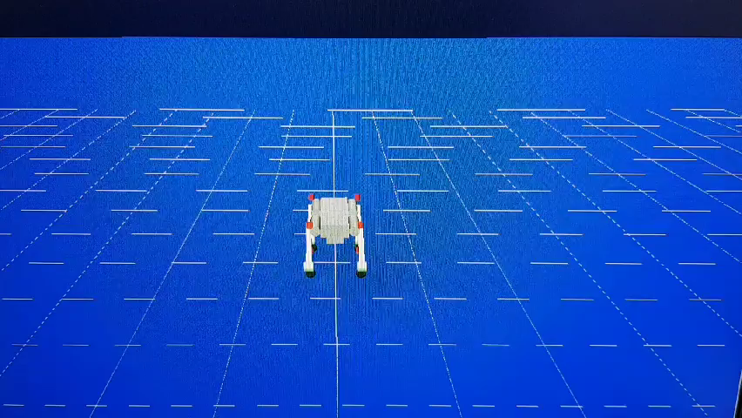
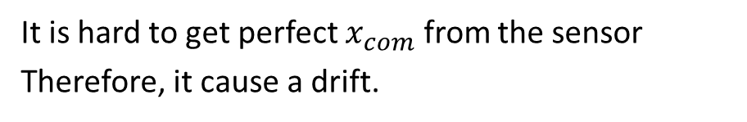
3. High-Level Controller
It is hard to get perfect $x_{com}$ from the sensor
Therefore, it cause a drift.

Slide 13
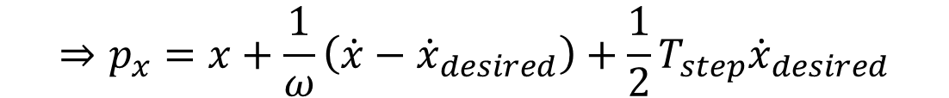
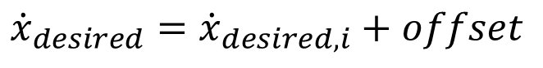
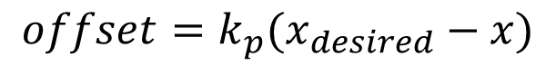
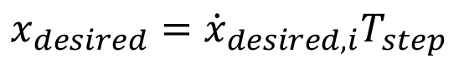
3. High-Level Controller
A drift-compensation loop is added to feedback loop
$$x_{desired}={\dot{x}}_{desired,i}T_{step}$$
$$offset=k_{p}(x_{desired}−x)$$
$${\dot{x}}_{desired}={\dot{x}}_{desired,i}+offset$$
$$⇒p_{x}=x+\frac{1}{ω}\left(\dot{x}−{\dot{x}}_{desired}\right)+\frac{1}{2}T_{step}{\dot{x}}_{desired}$$

Slide 14
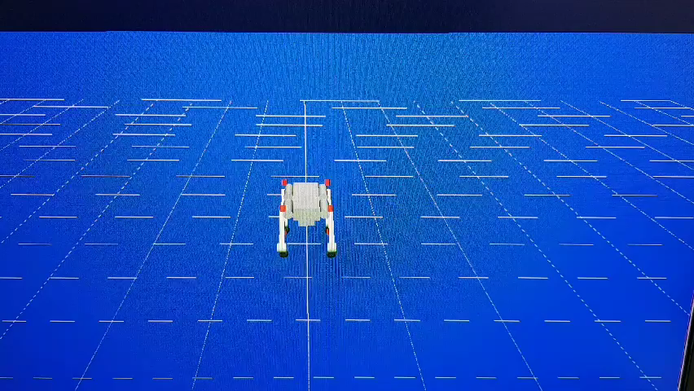
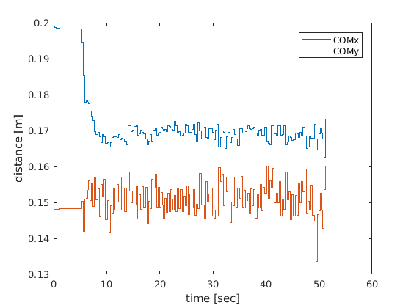
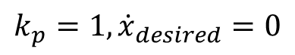
3. High-Level Controller
$$k_{p}=1,{\dot{x}}_{desired}=0$$

Slide 15
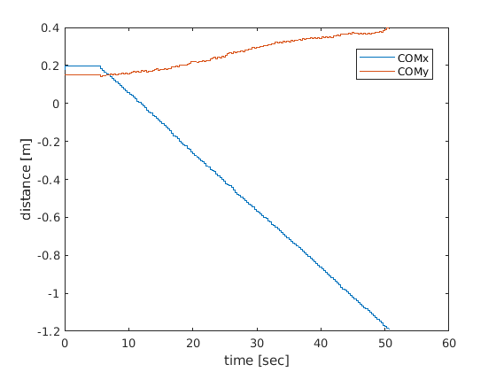
3. High-Level Controller
Without feedback
With feedback

Slide 16
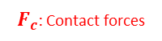
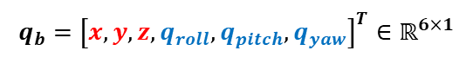

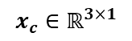
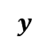
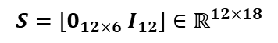
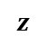


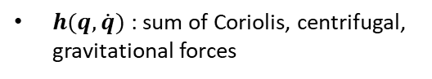
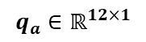
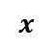
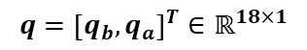

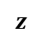

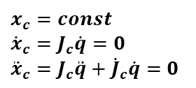

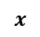
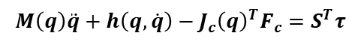



4. Low-Level Controller
l Low-level controller: optimization based inverse dynamics control
$q$: generalized coordinates in joint space
Floating base multi-body dynamics
$$q={\left[q_{b},q_{a}\right]}^{T}∈ℝ^{18×1}$$
$$z$$
Body frame
$$y$$
$q_{b}$ : under-actuated base coordinates
Under-actuated
base coordinates
$$x$$
$$q_{b}={\left[x,y,z,q_{roll},q_{pitch},q_{yaw}\right]}^{T}∈ℝ^{6×1}$$
$q_{a}$ : actuated joint coordinates
$$q_{a}∈ℝ^{12×1}$$
$$z$$
$x_{c}$: contact vector in Cartesian space
$$y$$
$$x_{c}∈ℝ^{3×1}$$
$$x$$
$F_{c}$: Contact forces
$M(q)$ : mass matrix
Inertial frame
$h(q,\dot{q})$ : sum of Coriolis, centrifugal, gravitational forces
Equations of Motion:
$τ$ : actuator torque
$$M\left(q\right)\ddot{q}+h\left(q,\dot{q}\right)−J_{c}{\left(q\right)}^{T}F_{c}=S^{T}τ$$
$S$ : selection matrix
$$S=[0_{12×6} I_{12}]∈ℝ^{12×18}$$
Constraint Equations:
$F_{c}$ : contact forces
$x_{c}=const$
${\dot{x}}_{c}=J_{c}\dot{q}=0$
${\ddot{x}}_{c}=J_{c}\ddot{q}+{\dot{J}}_{c}\dot{q}=0$
$$F_{c}∈ℝ^{3n_{c}×1} (n_{c}:number of contact points)$$
$J_{c}$ : support Jacobian
$$J_{c}∈ℝ^{3n_{c}×18} (n_{c}:number of contact points)$$
Notes:
통상적인 로봇 컨트롤 프레임워크에 대한 전반적인 설명

Slide 17
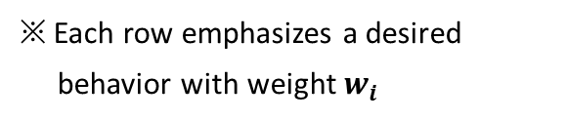
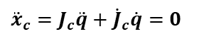
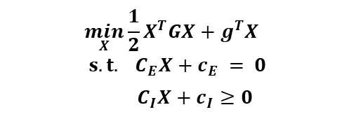
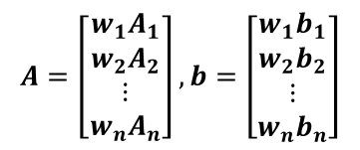

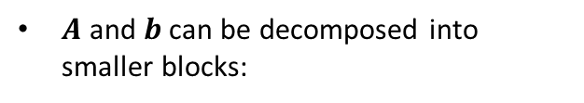
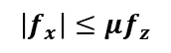
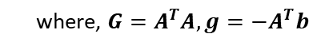
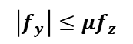
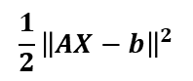
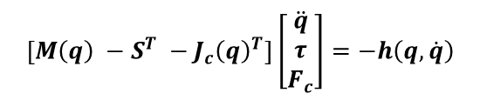
4. Low-Level Controller
l Low-level controller: optimization based inverse dynamics control
Quadratic programming:
Formulate inverse dynamics as QP problem:
$$\min_{X}{\frac{1}{2}X^{T}GX+g^{T}X}$$
$$s.t. C_{E}X+c_{E} = 0$$
$C_{I}X+c_{I}≥0$
Equality Constraint
1) Equations of Motion
$$\left[M\left(q\right) −S^{T} −J_{c}{\left(q\right)}^{T}\right]\left[\begin{matrix}\ddot{q} \\ τ \\ F_{c}\end{matrix}\right]=−h\left(q,\dot{q}\right)$$
Optimize a cost function of the form:
$$\frac{1}{2}{\left\|AX−b\right\|}^{2}$$
where, $G=A^{T}A, g=−A^{T}b$
Inequality Constraint
$A$ and $b$ can be decomposed into smaller blocks:
1) Contact constraint
${\ddot{x}}_{c}=J_{c}\ddot{q}+{\dot{J}}_{c}\dot{q}=0$
$$A=\left[\begin{aligned}&{w_{1}A}_{1} \\ &w_{2}A_{2} \\ ⋮ \\ {w_{n}A}_{n}\end{aligned}\right], b=\left[\begin{aligned}&{w_{1}b}_{1} \\ &w_{2}b_{2} \\ ⋮ \\ w_{n}b_{n}\end{aligned}\right]$$
2) Friction cone approximation
$$\left|f_{x}\right|≤μf_{z}$$
where, $μ$: frictional coefficient
※ Each row emphasizes a desired
behavior with weight $w_{i}$
$$\left|f_{y}\right|≤μf_{z}$$
Notes:
통상적인 로봇 컨트롤 프레임워크에 대한 전반적인 설명

Slide 18
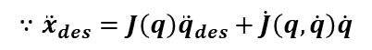










4. Low-Level Controller
l Low-level controller: optimization based inverse dynamics control
Formulate inverse dynamics as QP problem:
Cost Function
2) Cartesian space acceleration
$$A=\left[\begin{aligned}&{w_{1}A}_{1} \\ &w_{2}A_{2} \\ ⋮ \\ {w_{n}A}_{n}\end{aligned}\right], b=\left[\begin{aligned}&{w_{1}b}_{1} \\ &w_{2}b_{2} \\ ⋮ \\ w_{n}b_{n}\end{aligned}\right]$$
$$∵{\ddot{x}}_{des}=J\left(q\right){\ddot{q}}_{des}+\dot{J}\left(q,\dot{q}\right)\dot{q}$$
$$A_{cart}=\left[\begin{matrix}J(q) & 0 & 0\end{matrix}\right]$$
$$b_{cart}={\ddot{x}}_{des}−\dot{J}\left(q,\dot{q}\right)\dot{q}$$
※ Each row emphasizes a desired
behavior with weight $w_{i}$
$${\ddot{x}}_{des}=K_{p}\left(x_{ref}−x\right)+K_{d}\left({\dot{x}}_{ref}−\dot{x}\right)+{\ddot{x}}_{ref}$$
3) Direct tracking and regularization
$$A_{state}=I$$
1) Joint space acceleration
$$b_{joint}={\ddot{q}}_{des}$$
$$A_{joint}=\left[\begin{matrix}I & 0 & 0\end{matrix}\right]$$
$$b_{joint}={\ddot{q}}_{des}$$
4) Changes in torques
$${\ddot{q}}_{des}=K_{p}\left(q_{ref}−q\right)+K_{d}\left({\dot{q}}_{ref}−\dot{q}\right)+{\ddot{q}}_{ref}$$
$$A_{cart}=\left[\begin{matrix}0 & I & 0\end{matrix}\right]$$
$$b_{joint}=τ_{previous}$$
Notes:
통상적인 로봇 컨트롤 프레임워크에 대한 전반적인 설명

Slide 19


4. Low-Level Controller
l Low-level controller: optimization based inverse dynamics control
High-level controller with:
Low-level Position control
Low-level Torque control
Stiff: hard to adapt impact force
Compliant: naturally adapt impact force
Notes:
통상적인 로봇 컨트롤 프레임워크에 대한 전반적인 설명

Slide 20



4. Low-Level Controller
l Low-level controller: optimization based inverse dynamics control
Preliminary performance:
Forward walk
Side walk
Turning walk
Notes:
통상적인 로봇 컨트롤 프레임워크에 대한 전반적인 설명

Slide 21






4. Low-Level Controller
l Low-level controller: optimization based inverse dynamics control
Preliminary performance:
Without contact constraints
With contact constraints
$$P_{null}(M\ddot{q}+h\left(q,\dot{q}\right))={P_{null}S}^{T}τ$$
$$M\left(q\right)\ddot{q}+h\left(q,\dot{q}\right)−J_{c}{\left(q\right)}^{T}F_{c}=S^{T}τ$$
Doesn’t need to consider contact force
Friction cone approximation
However, can’t consider contact constraints
$$\left|f_{x}\right|≤μf_{z}$$
where, $μ$: frictional coefficient
$$\left|f_{y}\right|≤μf_{z}$$
Notes:
통상적인 로봇 컨트롤 프레임워크에 대한 전반적인 설명

Slide 22
5. Result & Future Work
l Preliminary result:
Drift compensation
Compliant foot landing
Uneven terrain: Slope
Forward walk
Side walk
Turning walk
Without feedback
With feedback
Slope (over 30°)
l Future work:
Uneven terrain: debris
Push recovery: withstand 200~600 N push
Versatile dynamic gaits: trot, pace, bound, etc.

Slide 23
Q & A

